Slide 1
T1A2 – PORTFOLIO
NIKOLAOS MAKRAKIS

Slide 2
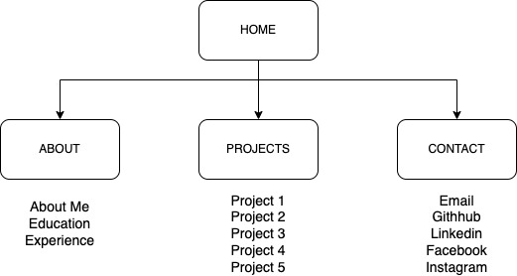
Sitemap

Slide 3
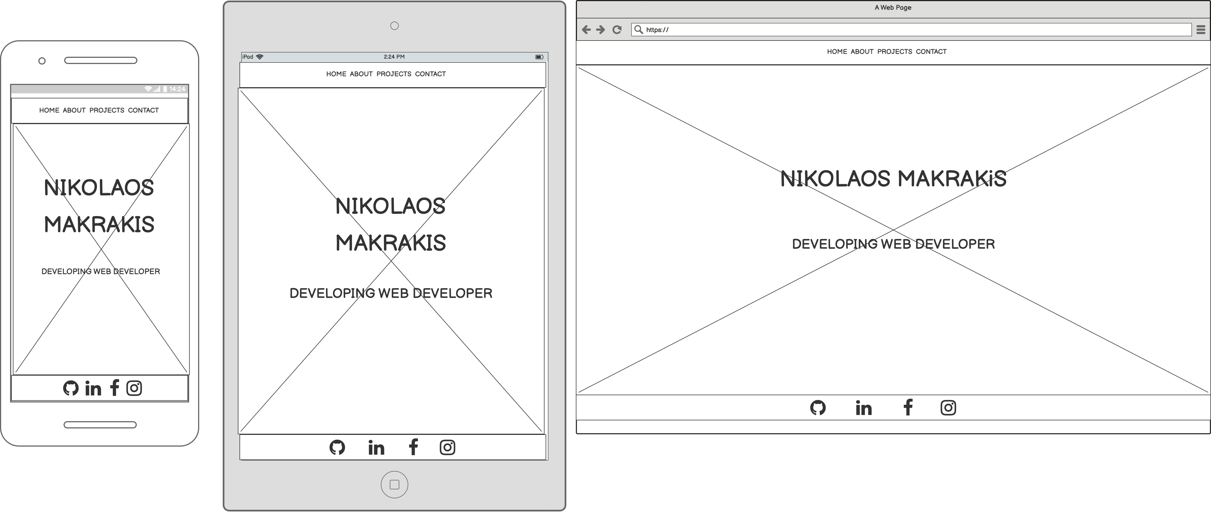
Home Page

Slide 4
Home Page
Modern design.
Background image with an overlay to allow for the text to stand out.
Nav-bar stuck to the top with all the links to the other pages.
Footer stuck to the bottom with links to my socials.

Slide 5
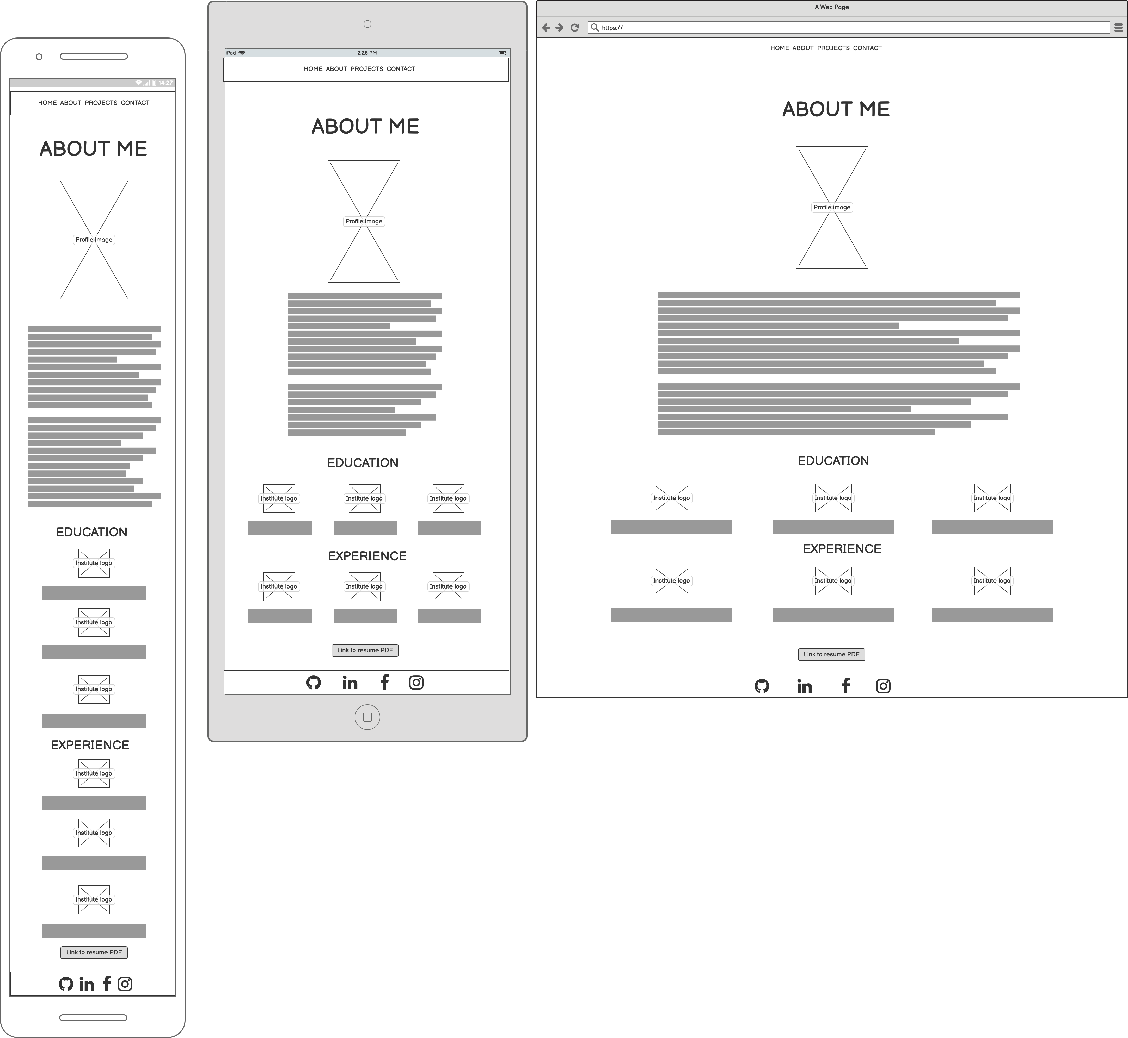
About

Slide 6
About
Dark background with white text to flow with the colors of the other pages.
Profile image that shows that while I am a professional I am also fun.
Education & Experience has a different background to show that it’s a different section.
Goes from single column to three columns when on a larger screen.
Components set with an image to show the logo of the institutes.
Button at the bottom that downloads my resume.
Footer stuck to the bottom.

Slide 7
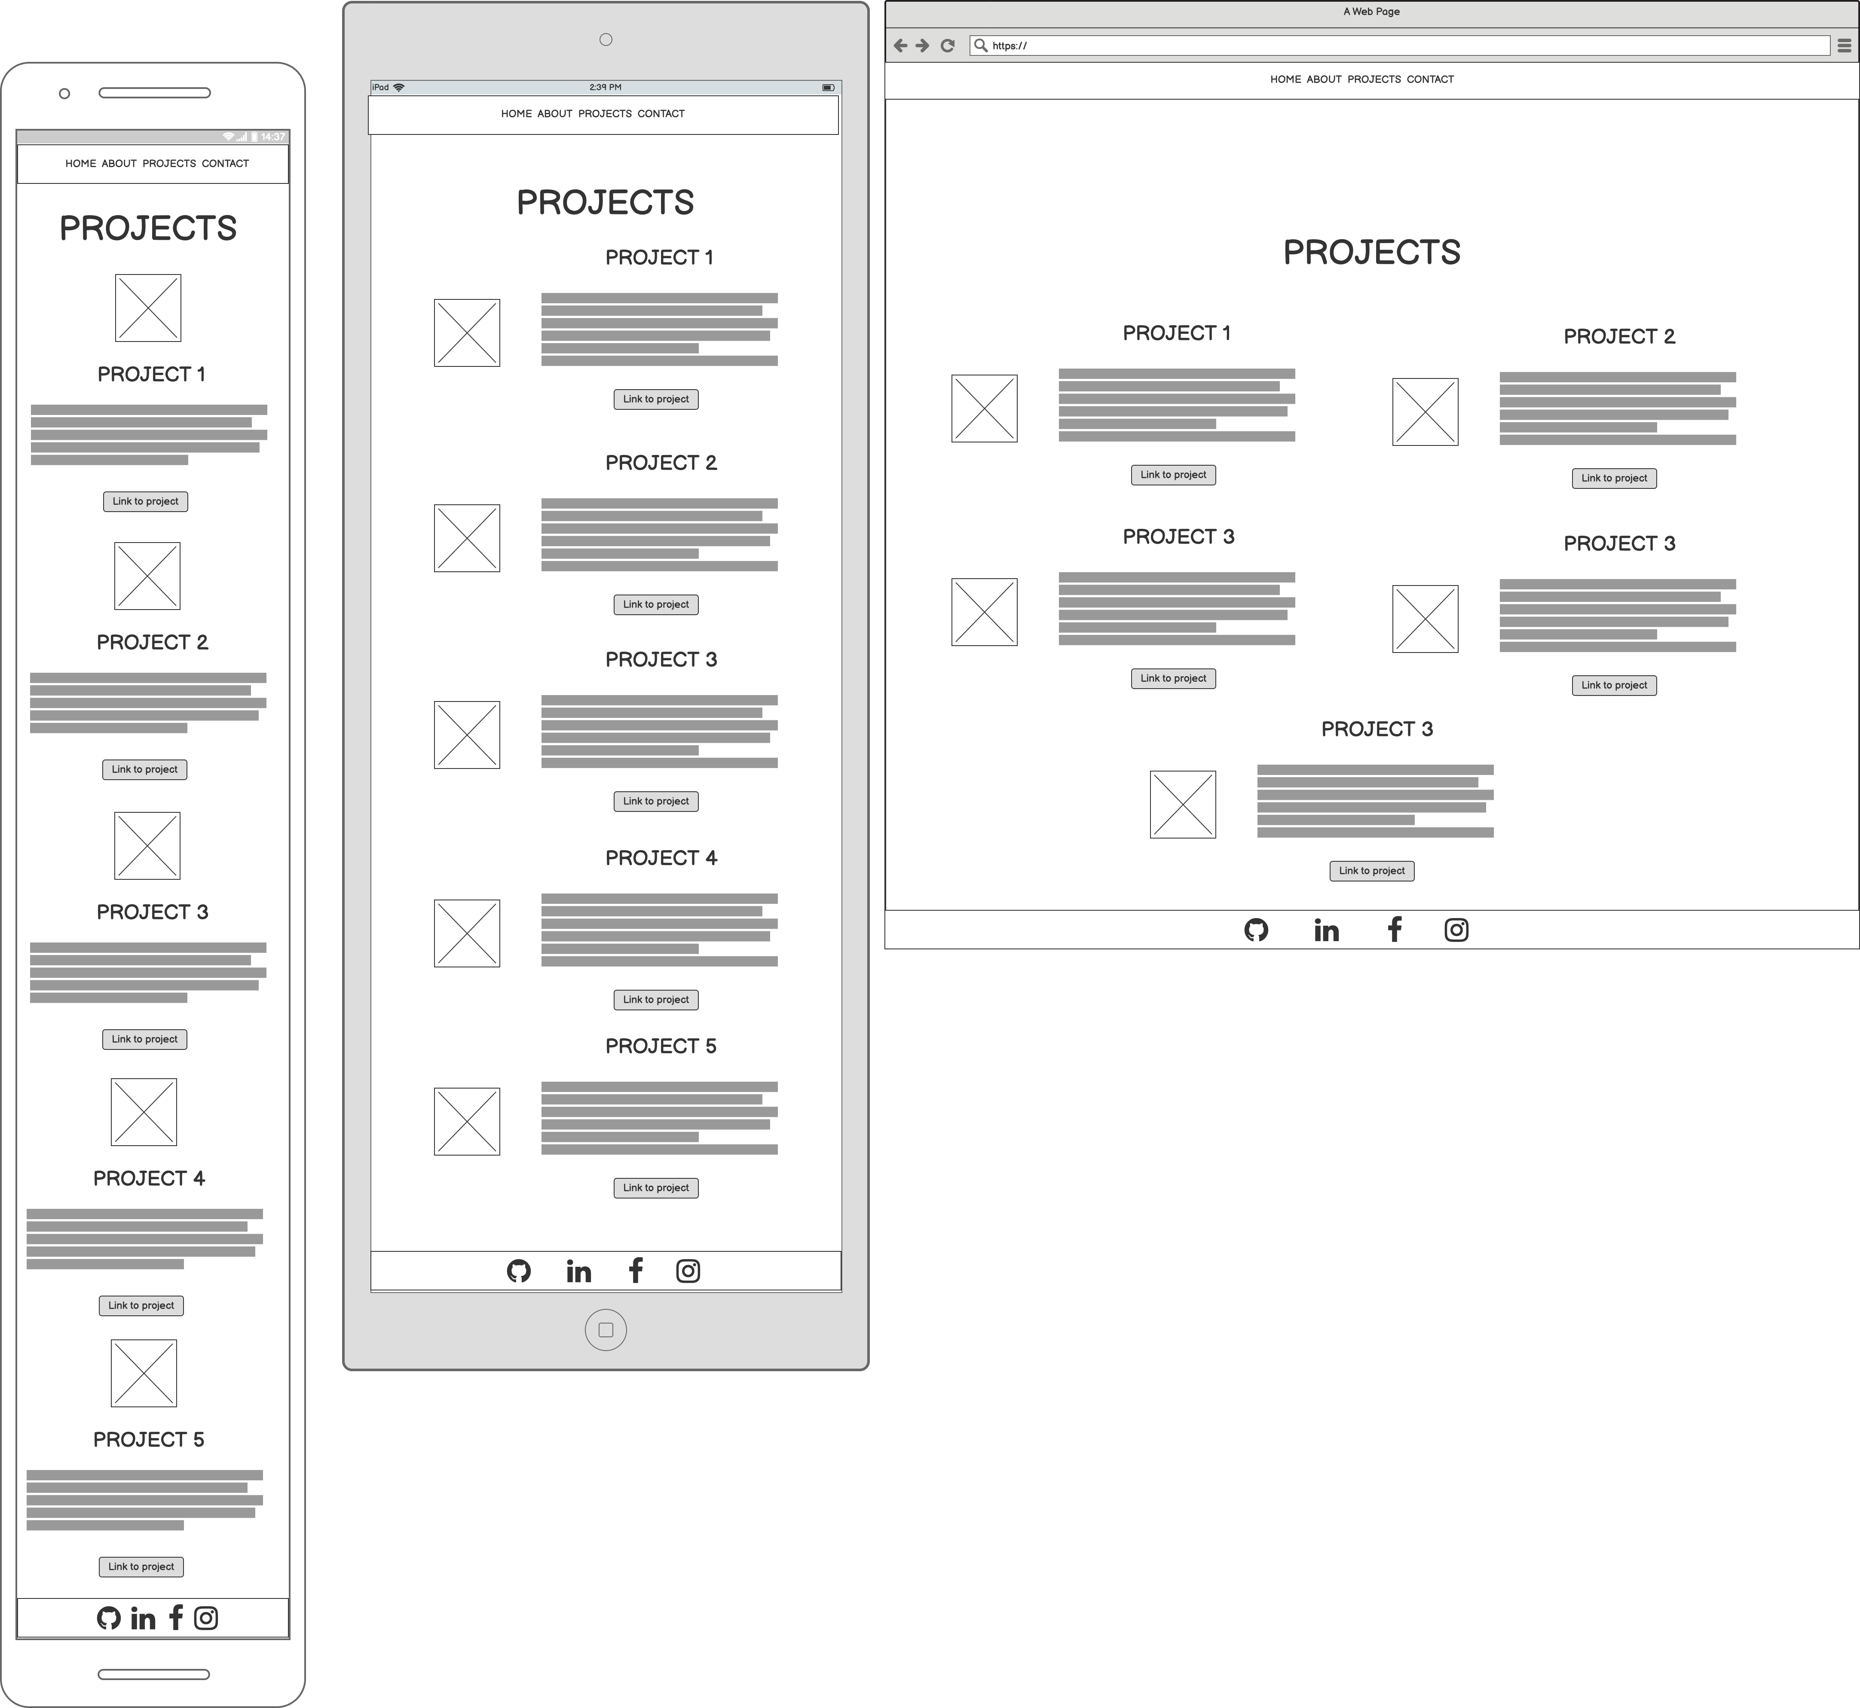
Projects

Slide 8
Projects
Dark background with white text to flow with the colors of the other pages.
Projects separated by a border to make them “pop”.
Each project has an image, text, and link that relate to the project.
Single column on mobile, single column and rearranged on tablet, dual column on pc.
Footer stuck to the bottom.

Slide 9
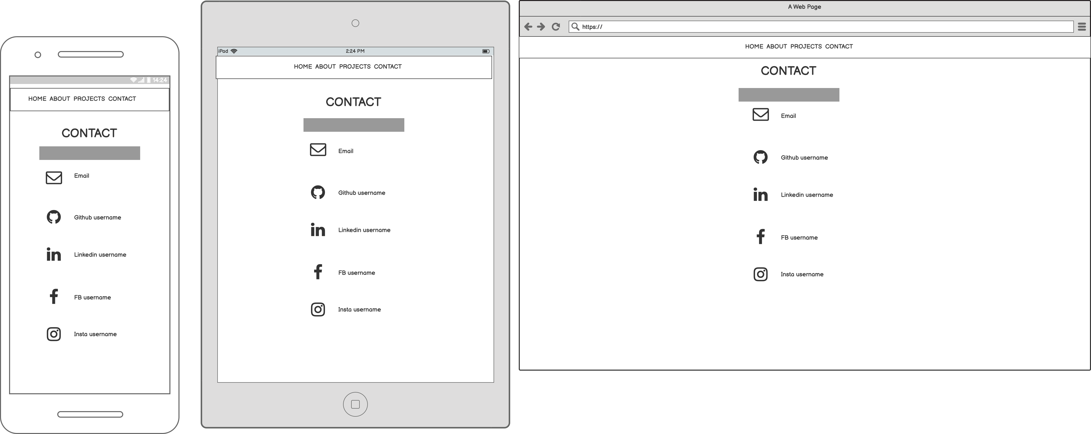
Contact

Slide 10
Contact
Dark background with white text to flow with the colors of the other pages.
Links with icons for all socials and email.
Footer removed to avoid redundancy.

